Slide 1

MSE 311: Thermodynamics of Materials
Lecture-02:
Heat and Energy
2022 Fall
Weishu Liu
Department of Materials Science and Engineering
Southern University of Science and Technology (SUSTech)
Email: liuws@sustech.edu.cn
Office: North Tower, Rm310
Sep 7，2018
Prof. W.S. Liu | 1

Slide 2

2. Heat and Energy Conservation
Chapter 2
Introduction to the thermodynamics of materials,
5th or 6th edition, by David R. Gaskell, Taylor & Francis Press, 2018

Slide 3
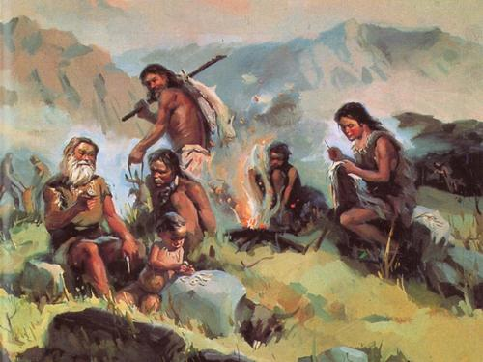
Civilization is initiated from how to use the fire

Slide 4
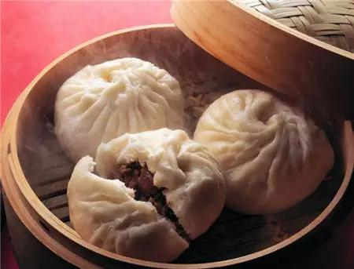
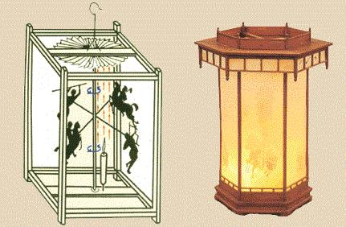

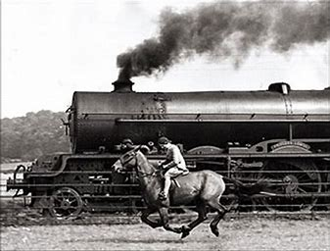
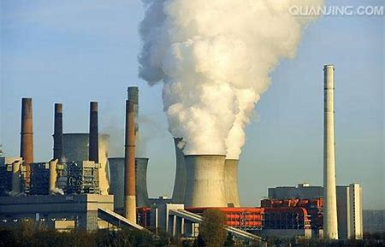

Civilization is initiated from hot to use the fire
唐诗 宋词
Industry Innovation, WW I, WWII
Notes:
Recall the concept of equilibrium

Slide 5
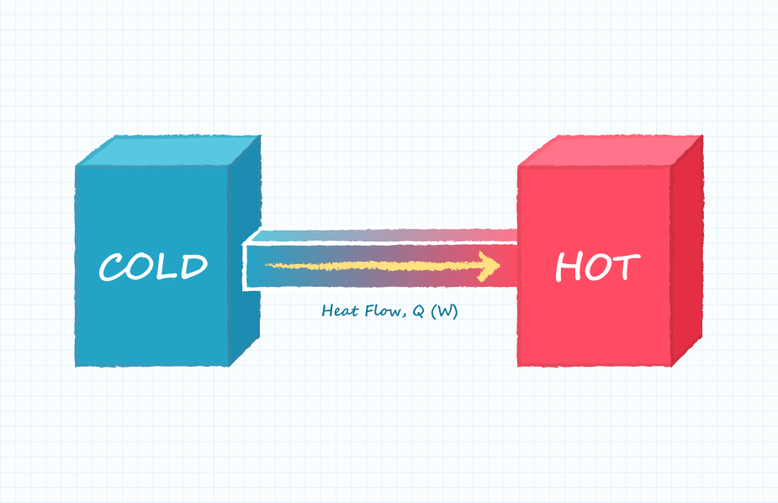
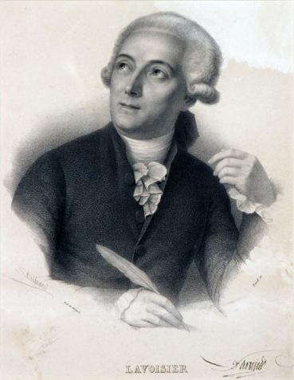
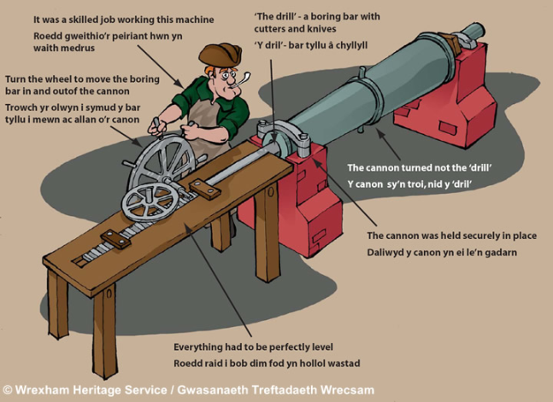
A short history of heat
The materiality of heat
It is a wrong theory.
It come to great conclusion, the Conservation
Antoine Lavoisier
French Chemist
(1771 - 1794)
The kinetic theory of Heat
1798 : Count Rumford first suggest that the relationship
between heat (thermal energy) and work.
” the heat, q , produced during the boring was roughly proportional to the work, w ,”

Slide 6
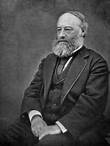
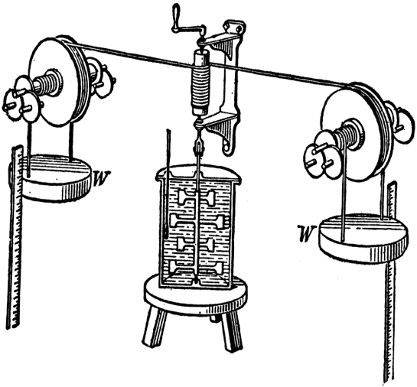
Heat and Work
Systematic investigation:
1. Rotating a paddle wheel immersed in the water
2. An electric motor driving a current through a coil immersed in the water
3. Compressing a cylinder of gas immersed in the water
4. Rubbing together two metal blocks immersed in the water
James Joule
(1818– 1889).
“Heat” is that quantity which, in a system, is conserved in the absence of work done on or by that system.
“Heat”= internal energy

Slide 7
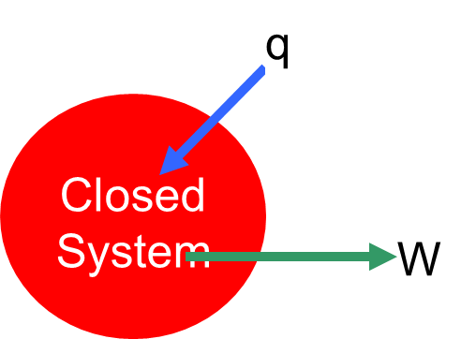
Heat and Work
Heat (q): energy exchange due to temperature difference.
q is positive when heat flows into the system
q is negative when heat flows out the system
Work (w): energy exchange due to other driving forces.
Work done by the system to the surroundings is positive
Work done by the surroundings to the system is negative
Mechanical work: due to volume change
Both heat and work are process variables, they disappear when process finishes.

Slide 8
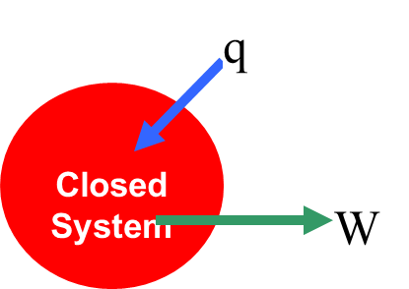
Energy conservation law
First Law of thermodynamics is also called as The energy conservation law
For an infinitesimal change: dU = δq – δW
d ➔ a differential element of a state function
δ ➔ a differential element of a non-state function
U is the state function, independent on process
While, both q and w depend on process
So, for cyclic process (the system come back to the initial state after the process):
And

Slide 9
Path dependent / Independent
Work: Path dependent
Internal energy: Path independent

Slide 10

Four classic processes
PV-Work: Path dependent
Constant Volume Process, V= const.
Constant Pressure Process, P=const.
Reversible Adiabatic Process, δq=const.
Reversible Isothermal Process, δT=const.

Slide 11
Constant Volume Process
P₁
1
Pressure
2
P₂
Volume
V₁=V₂
The change in internal energy of a system is equal to the heat absorbed (if dU>0, the system absorbs heat, while if dU<0, the system actually release heat) by the system

Slide 12
Constant Pressure Process
1
2
P
Pressure
Volume
V₁
V₂
Enthalpy, H = U + PV
H is a new state function.

Slide 13
Reversible Adiabatic Process
Condition:
no heat exchange → δ q =0
dU = δq - δw = -δw
dU = c_{v}dT and δw = PdV
For ideal gas:
or
R = c_{p} – c_{V}, and let c_{p}/c_{V} = γ, γ = 1 + R / C_{V}

Slide 14
Reversible Adiabatic Process
For ideal gas:
PV=nRT
The relationship between the pressure and the volume of an idea gas undergoing a reversible adiabatic process

Slide 15
Reversible isothermal Process
dT = 0 (isothermal process), dU = 0

Slide 16
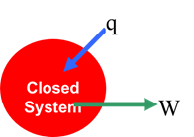
Comparison
Constant Volume Proc.
w=0, q=ΔU
w=P(V₂-V₁),
q – P(V₂ – V₁)=ΔU
Constant Press Proc.
Reversible Adiabatic Proc.
Reversible Isothermal Proc.
The amount of work generated from the heat highly depends on the process
What’s the nature of the process involving the transfer from heat to work?

Slide 17

General form of the 1st law of TD
dU = δq – δw
A positive δw’ means the work
done by the system.
Mechanical work, or PV work
Magnetic Work
on a Paramagnetic Material
Electrical Work
on a Dielectric Material
Work
to Create or Extend a Surface
δw=pdV
The system with only PV works is also called simple system

Slide 18
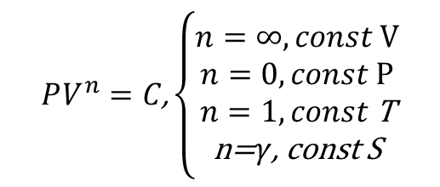
Polytropic process
Constant Volume Process, V= const.
Constant Pressure Process, P=const.
Reversible Adiabatic Process, δq=const.
Reversible Isothermal Process, δT=const.
P
$$PV^{n}=C\text{,}\left\{\begin{matrix}n=∞,const V \\ n=0,const P \\ n=1,const \text{T} \\ \text{n}\text{=}γ\text{, }\text{const} \text{S}\end{matrix}\right.$$
V

Slide 19
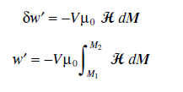


Magnetic Work on a Magnetic Material
The work done on a Paramagnetic material by an external magnetic field is given by
V: volume [m³]
H: strength of the magnetic filed, [A/m]
M: magnezation, [A/m]
μ₀: permeability of vacuum, [N A⁻²]
For an adiabatic process at constant volume

Slide 20
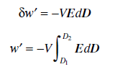


Electric Work on a Dielectric Material
The work done on a dielectric material by an external electric field is given by
V: volume [m³]
E: strength of the electrical filed, [N/C]
D: electric displacement, [C/m²]
ε₀: permittivity of vacuum, [N A⁻²]
For an adiabatic process at constant volume

Slide 21



Work to create a new surface
The reversible work done in creating a new surface (in joules) of area A is given as
γ: surface energy, [J/m²]
For an adiabatic process at constant volume

Slide 22
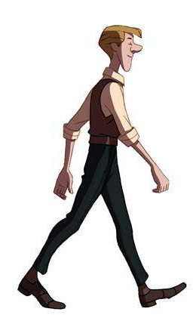
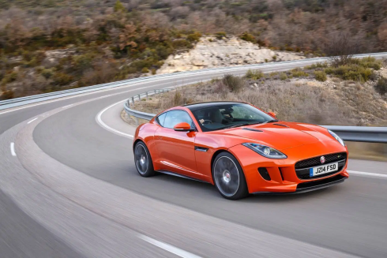
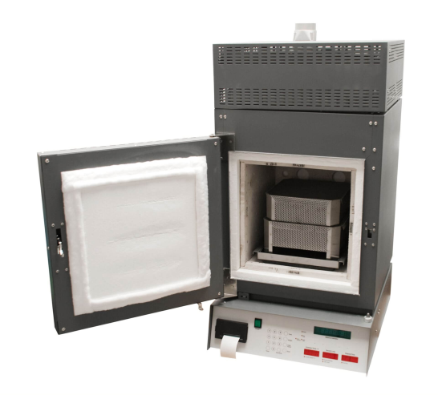

The importance of energy conservation
PV work
Magnetic
Electrical
Surface
Elastic
Chemical
Nuclear
The 1st law connected all the form of energy

Slide 23
3. Latent heat and Specific heat
Chapter 1
热力学，王竹溪，北京大学出版社
Chapter 2.6
Introduction to the thermodynamics of materials,
6th edition, by David R. Gaskell, Talor & Francis Press, 2018

Slide 24
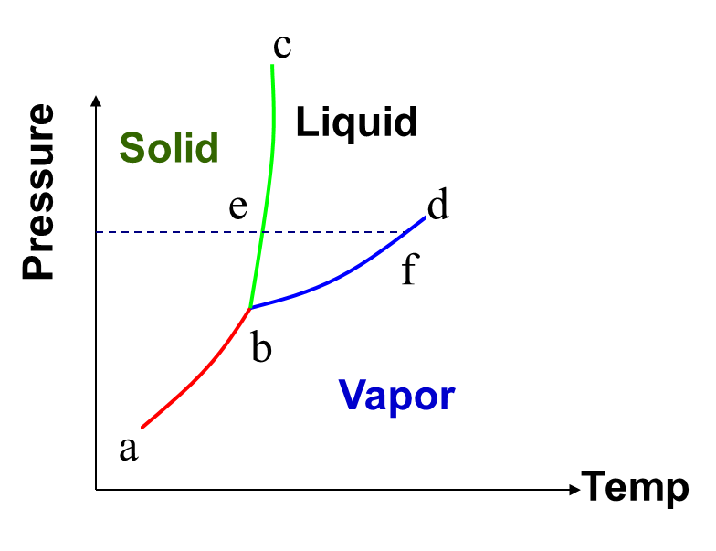
Heat Capacity
Heat Capacity (C): The ratio of heat transferred between the system and the surrounding divided by the resulted change in temperature of the system
Specific Heat Capacity (c): heat capacity / mole
Heat transferred
Temperature change
A Material Property?
Process Dependence?
Phase Transition

Slide 25
Heat Capacity: C_{V} and C_{P}
Constant Volume Process (C_{V}):
dU = δq – δW = δq
or dU=C_{v}dT
Constant Pressure Process (C_{P}):
dH =dU+pdV= δq
or dH=C_{P}dT

Slide 26
The relation between C_{V} and C_{P}
For any substances: c_{P} > c_{V}
c_{V}: heat solely used to raise temperature;
c_{P}: raise temperature + work to expand

Slide 27
The relation between C_{V} and C_{P}
Represents the work done by the system per degree rise in temperature in expanding against the constant external pressure P acting on the system
Represents the work done by the system per degree rise in temperature in expanding against the internal cohesive forces acting between the constituent particles of the substance

Slide 28
The relation between C_{V} and C_{P}
Joule concluded that the internal energy of a gas (ideal) is a function of temperature only.
For idea gas:
For liquid or solid
For ideal gas:

Slide 29
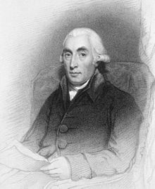
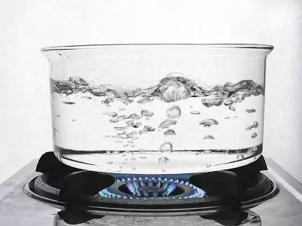
Latent heat
Latent Heat：energy released or absorbed, by a body or a thermodynamic system, during a constant-temperature process, usually a first-order phase transition.
Joseph Black
Scottish physicist
(1728 –1799)

Slide 30
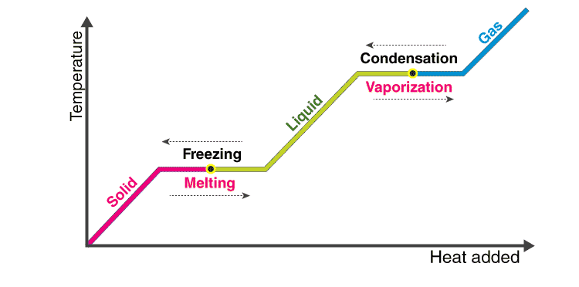
Latent heat
Latent heat is the work that is needed to overcome the attractive forces that hold molecules and atoms together in a substance.
Suppose a solid substance is changing to a liquid, it needs to absorb energy to push the molecules into a wider, more fluid volume.
Similarly, when a substance changes from a gas phase to a liquid, their density levels also need to go from lower to a higher level wherein the substance then needs to release or lose energy so that the molecules come closer together.

Slide 31
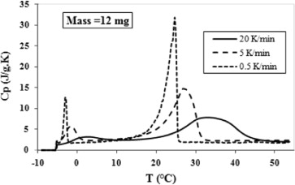
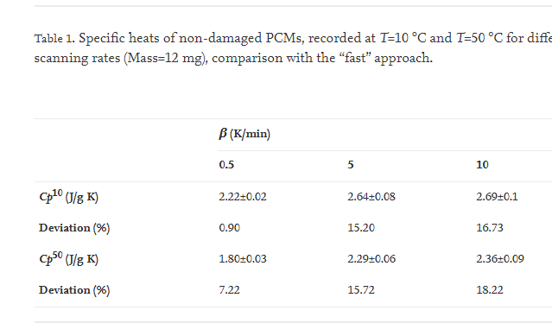
Latent heat measured by DSC
Effect of scanning rates
Journal of Building Engineering 1, 13-19， 2015

Slide 32
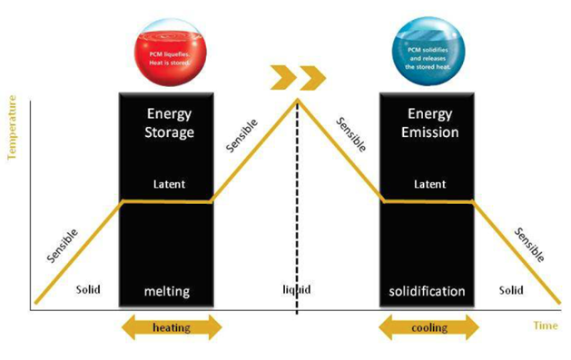
Latent heat – energy storage
A phase change material (PCM) is a substance which releases/absorbs sufficient energy at phase transition to provide useful heat or cooling. Using PCM to store heat energy provides much higher energy storage density with a smaller temperature swing when compared with the sensible heat storage method.

Slide 33
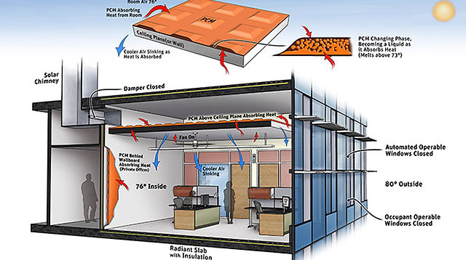
Latent heat – energy storage
PCM Changing Phase.
Becoming a liquid as it Absorbs Heat
(Melts above 23℃）
24.5℃ Inside
27℃ Outside
PCMS can be for heating and cooling in buildings. PCM can be placed in porous construction material such as plasterboard to increase heat. As for cooling, air conditioners with PCM collect and store ambient air during the night.
American Journal of Energy Engineering, 3(3): 46-52, 2015

Slide 34
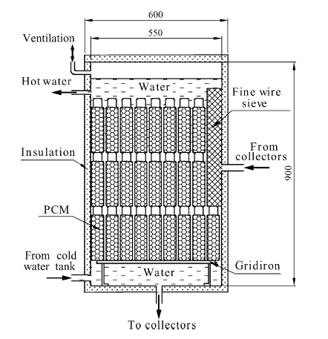
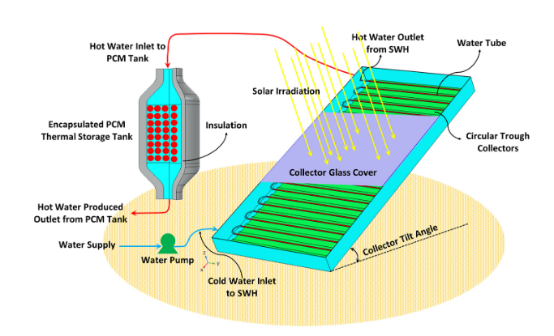
Latent heat – energy storage
(a)
(b)
Solar DHW systems combined with PCM: (a) Integrated and (b) Non-Integrated.
The efficiency of the solar collectors can be enhanced either by minimizing the thermal and optical losses or by integrating PCMs in the collector, which leads to extended operation hours and thermal stability. The PCM can be integrated either in the collector or in separate thermal energy storage tank.
Energy and Buildings, 37: 235-242, 2005; Sustainable Energy Technologies and Assessments, 47: 101350, 2021

Slide 35
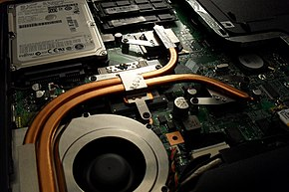
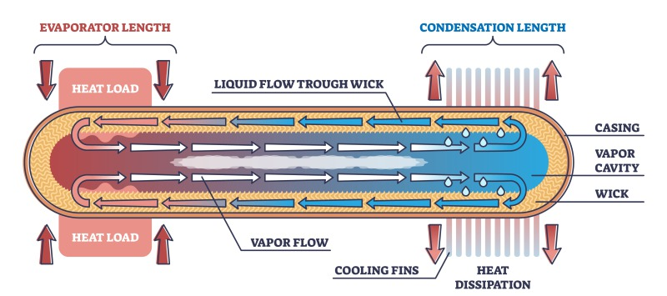
Latent heat – heat pipe
A heat pipe is a heat-transfer device that employs phase transition to transfer heat between two solid interfaces.
At the hot interface of a heat pipe, a volatile liquid in contact with a thermally conductive solid surface turns into a vapor by absorbing heat from that surface.
The vapor then travels along the heat pipe to the cold interface and condenses back into a liquid, releasing the latent heat.
The liquid then returns to the hot interface through either capillary action, centrifugal force, or gravity and the cycle repeats.
A laptop computer heat pipe system
100×100×10 mm high thin flat heat pipe
The effective thermal conductivity varies with heat pipe length, and can approach 100 kW/(m⋅K) for long heat pipes, in comparison with approximately 0.4 kW/(m⋅K) for copper.

Slide 36
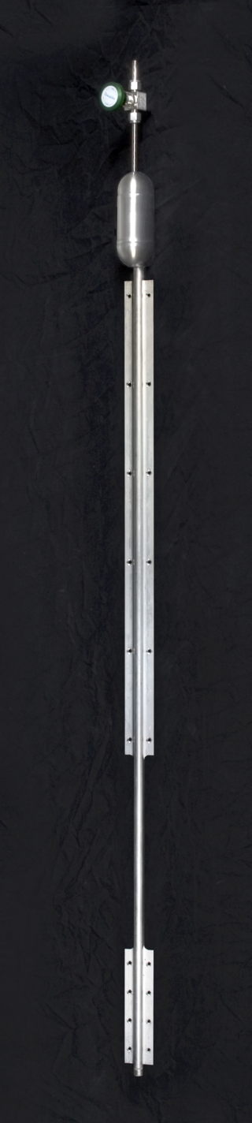
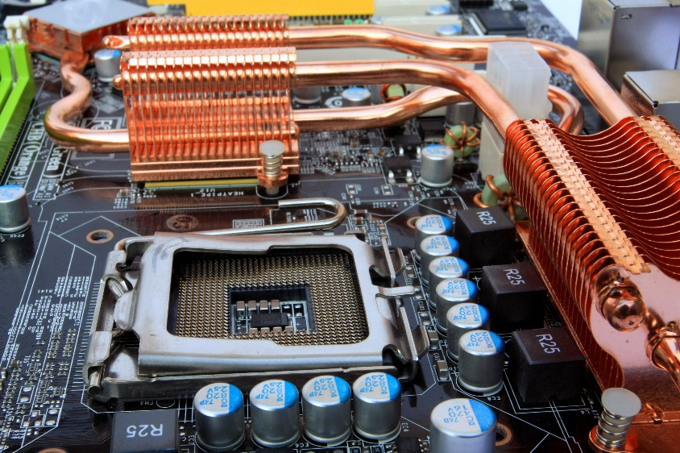
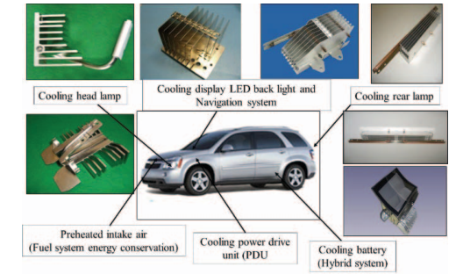
Latent heat – heat pipe
Heat pipe is a best known passive cooling & heating device which is excellent in heat transfer and low thermal resistance. There are many applications for heat pipes in computer and electronics, automotive, aviation, healthcare, energy saving, global warming, and environmental protection.
Heat pipes in computer and electronics
Heat pipes in automotive
Typical grooved aluminium-ammonia Variable Conductance Heat Pipes (VCHP) for spacecraft thermal control, with the evaporator section on the bottom, and the non-condensable gas reservoir just below the valve

Slide 37
Open question
What else application relative to latent heat?

Slide 38


Philosophical enlightenment
Fact one: Cp > Cv
外界的压力让你让你拥有更大的能力
Fact two: latent heat
当你感觉到你已经到了所能承受压力极限的时候
恭喜你，你将迎来华丽的变身
中国强调：闭关修炼
西方强调：实战提升

Slide 39
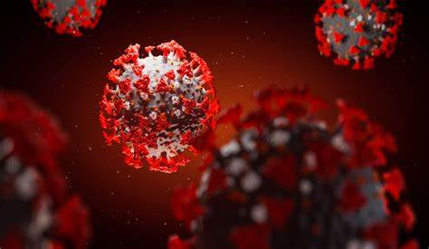
Home work:
Proposal facility to kill cornonavirus by using heat!
Open Question:
The importance of the 1st law of TD.

Slide 40
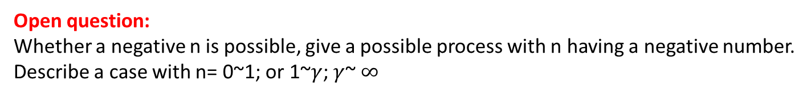
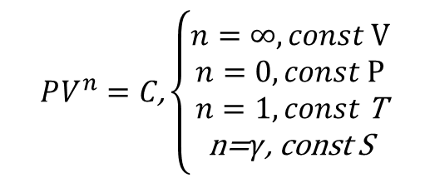
Polytropic process
Constant Volume Process, V= const.
Constant Pressure Process, P=const.
Reversible Adiabatic Process, δq=const.
Reversible Isothermal Process, δT=const.
P
$$PV^{n}=C\text{,}\left\{\begin{matrix}n=∞,const V \\ n=0,const P \\ n=1,const \text{T} \\ \text{n}\text{=}γ\text{, }\text{const} \text{S}\end{matrix}\right.$$
V
Open question:
Whether a negative n is possible, give a possible process with n having a negative number.
Describe a case with n= 0~1; or 1~$γ$; $γ$~ $∞$

